Slide 1

OOPS quiz
A c++ Project on:

Slide 2
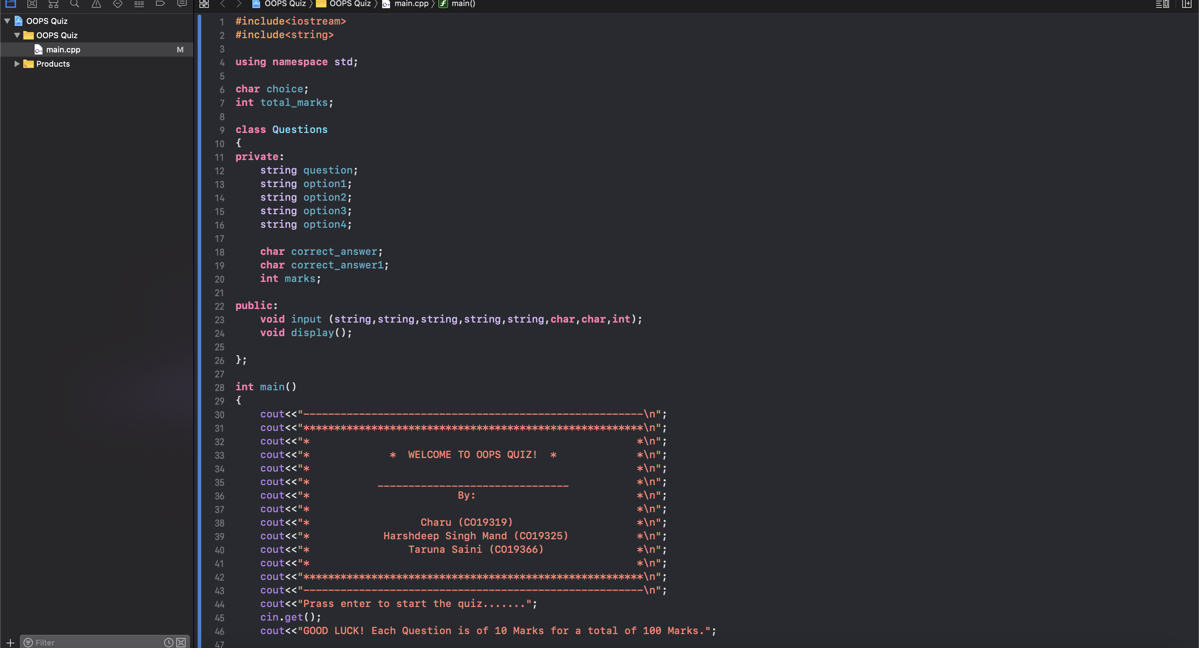
Class and welcome message
First section of the code:

Slide 3
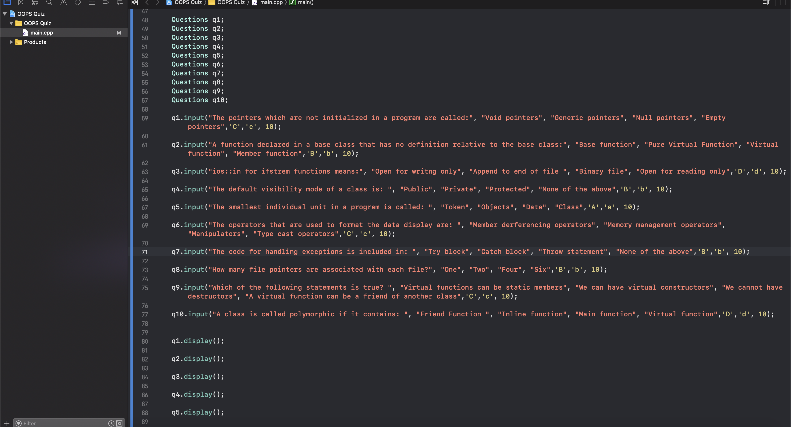
Input of questions
Second section of the code

Slide 4
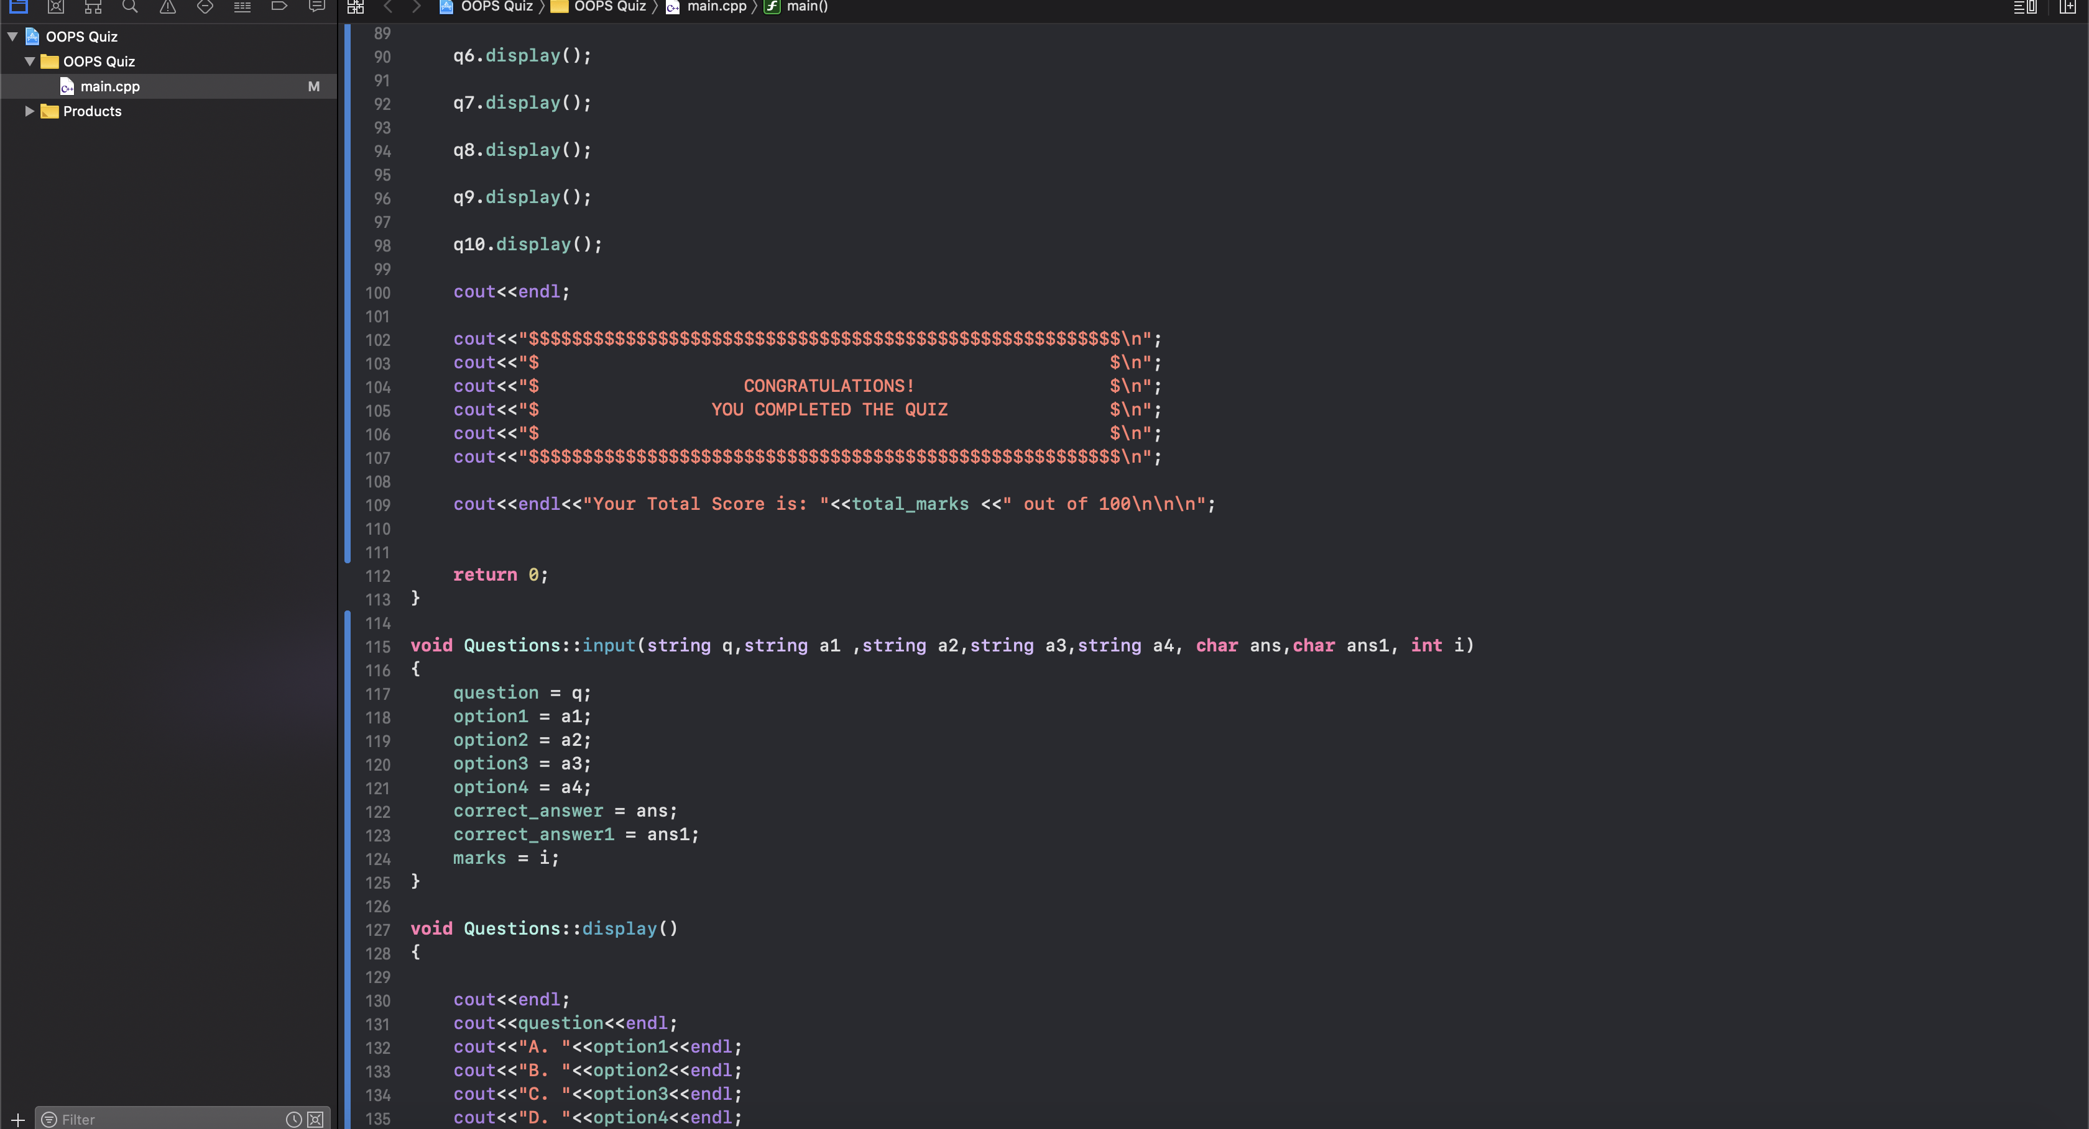
Defining input function
Third section: outro message and

Slide 5
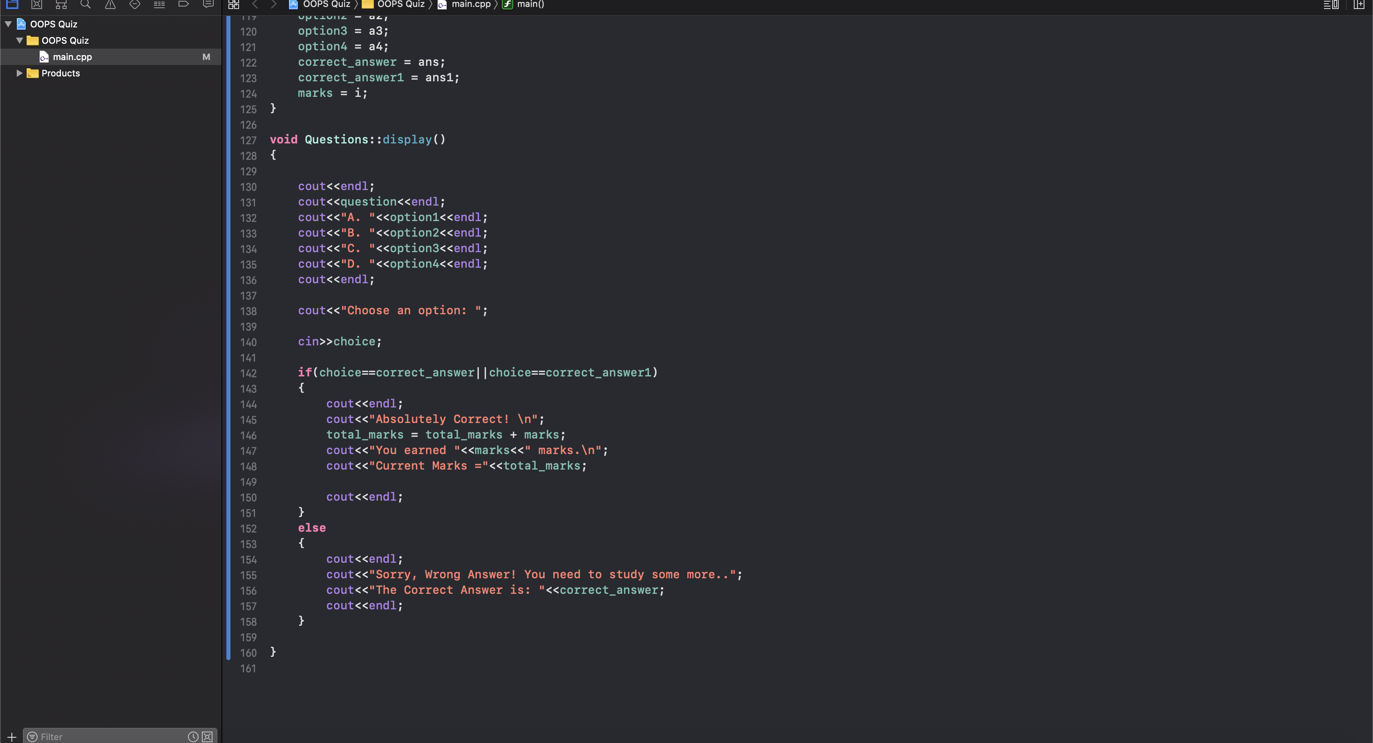
Defining display function
finally, adding up score and

Slide 6
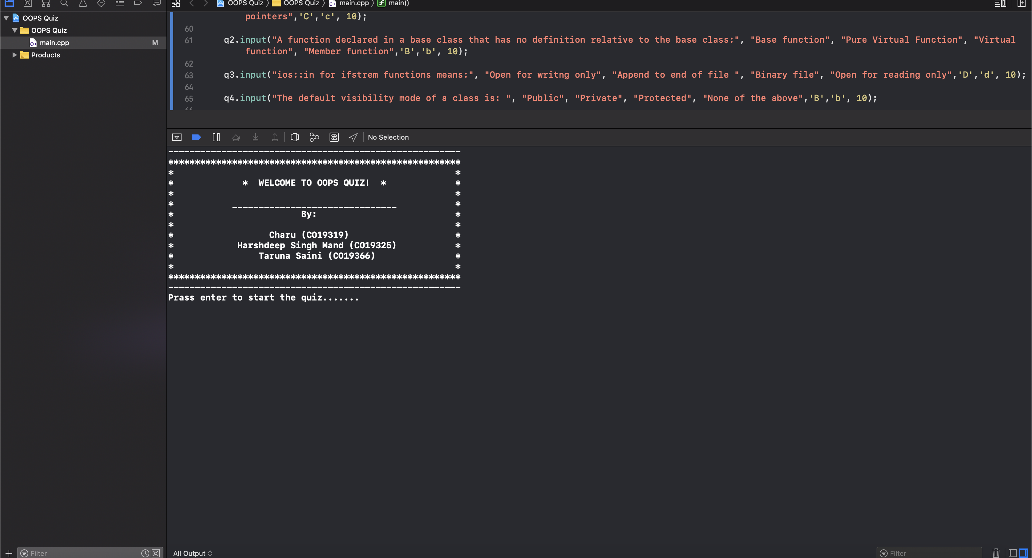
Welcome message shown
When the program is run:

Slide 7
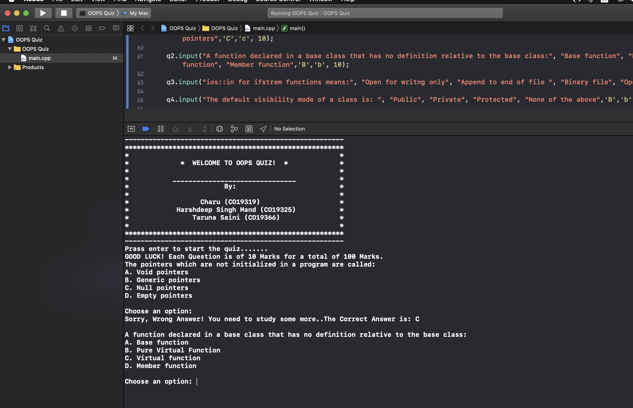
First question shows up
Enter is pressed and

Slide 8
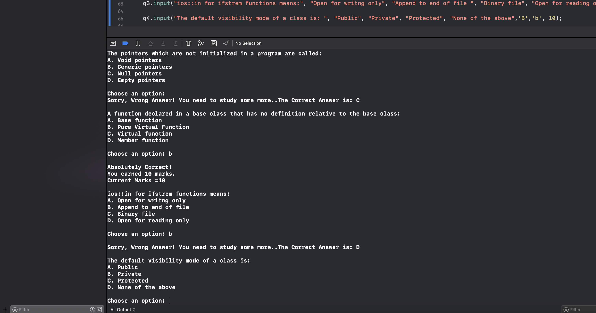
correct one adds 10 marks
Wrong option shows correct answer and

Slide 9
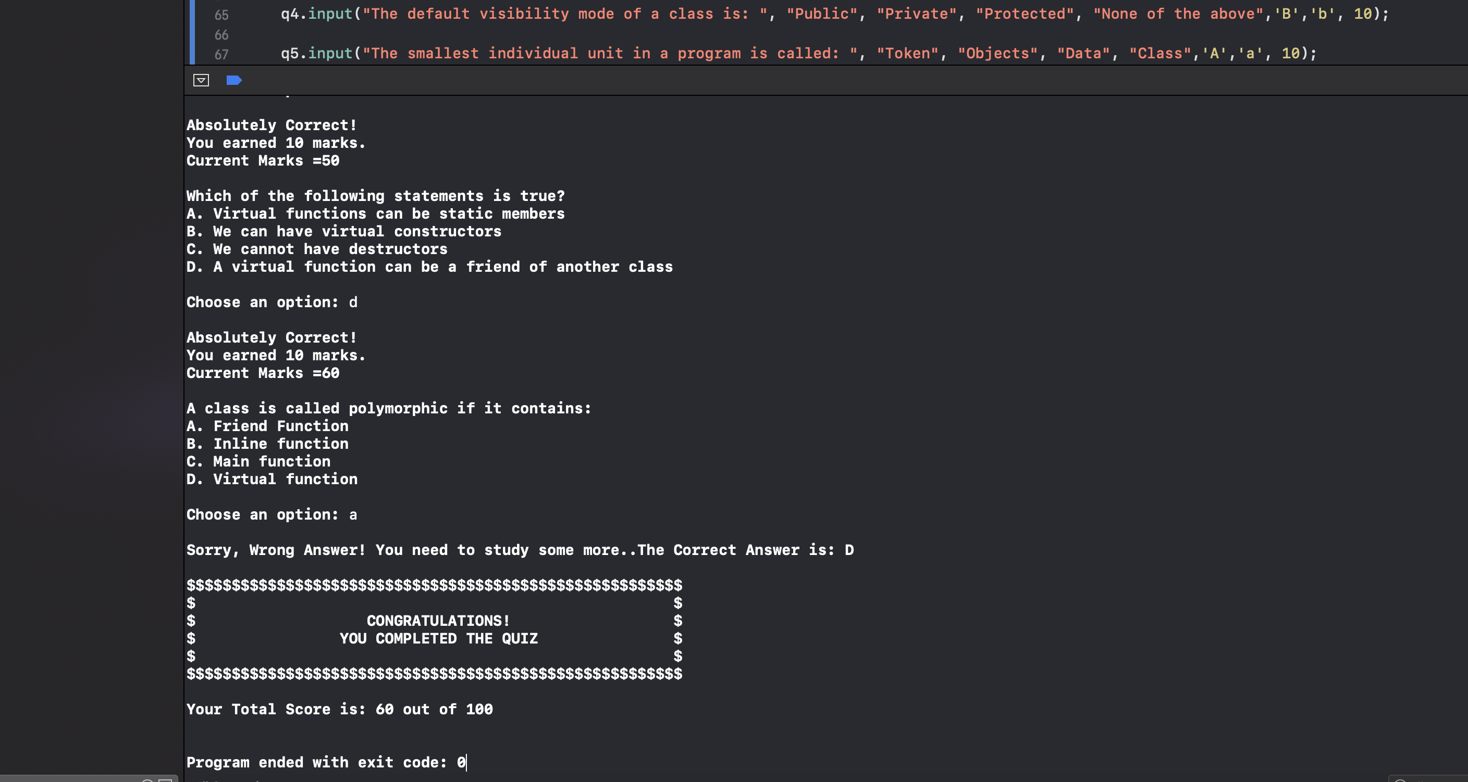
And total marks are given
Finally in the end completion message is printed

Slide 10
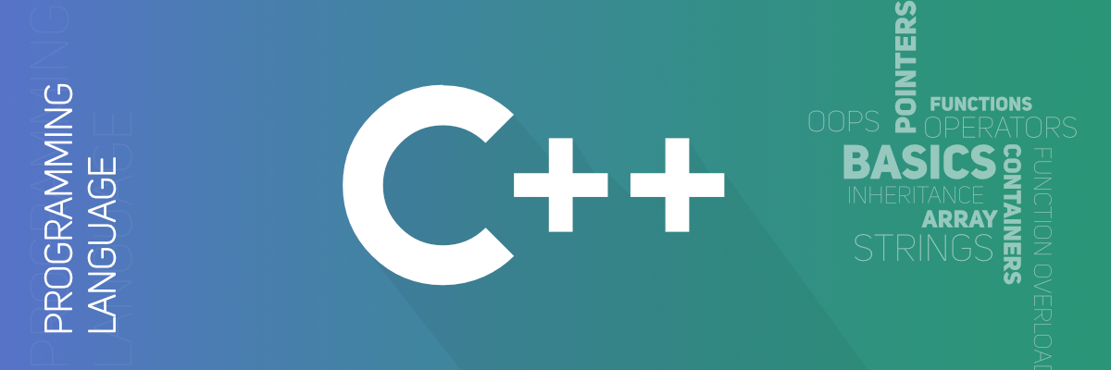
Xcode using c++ language
This project was made on:

Slide 11
Submitted by:
Charu - CO19319
Harsh Mand - CO19325
Taruna Saini - Co19366

Slide 12
THANK YOU!

